Slide 1

Student Details
Name: Meghraj Dilip Patil
SkillsBuild Email ID: meghraj312002@gmail.com
College Name: Dr Babasaheb Ambedkar Technological University Lonere
College State: Maharashtra
Internship Domain and Internship Start and End Date: 13th October 2023 to 26th November 2023.

Slide 2
Image steganography Using lsb method
Welcome to my presentation on Least Significant Bit Steganography. My name is MEGHRAJ DILIP Patil and I will be discussing my project as part of my CYBERSECURITY internship AT EDUNET FOUNDATION.

Slide 3
AGENDA
Introduction to LSB steganographyand Project overview
End users of my Projects
Solution of my project and its value proposition
Customization in my project the differentiating factor
Modelling of my project
Results of my projects
External links for reference

Slide 4
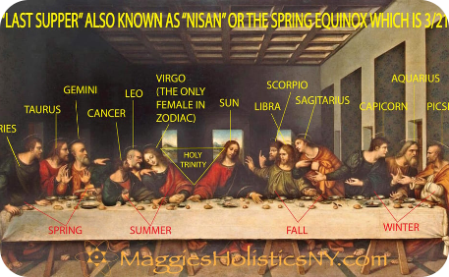

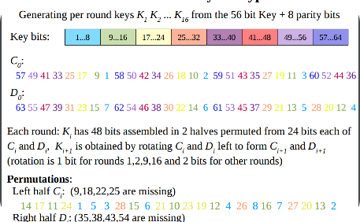
PROJECT OVERVIEW
The purpose of my project was to develop a tool that can be used to encode secret messages into digital images using the Least Significant Bit Steganography technique.
Encryption
Pixel Manipulation
Decryption
I explored various encryption techniques to ensure that the messages are secure and
cannot be easily decoded.
I used pixel manipulation algorithms to embed the messages into the least
significant bits of the image.
I also created a tool that can be used to extract the messages from the images using the same key used for encryption.

Slide 5
WHO ARE THE END USERS of this project?
The main target audience for my project is anyone who needs to securely transmit digital images with hidden information. This could include individuals or organizations in fields such as journalism, law enforcement, or intelligence agencies who need to share sensitive information while maintaining plausible deniability.

Slide 6
YOUR SOLUTION AND ITS VALUE PROPOSITION
My solution offers a simple and effective way to securely encode and decode messages in digital images while maintaining their visual appearance. By using the Least Significant Bit Steganography technique, my tool ensures that the hidden messages are virtually undetectable, making it an ideal choice for anyone who needs to communicate secretly while appearing normal.

Slide 7
How did you customize the project and make it your own
My code allows users to hide messages in images using steganography and retrieve them later with the correct password. The encoding process embeds the message in the image, and the decoding process extracts the hidden message using the provided password.I also created a user-friendly interface that allows anyone to easily encode and decode messages in just a few clicks. In addition, I extensively tested my tool to ensure that it can withstand various attack methods.
Adding passoword to encrypt and decrypt Image :- I added password and added encyrption to encode and decode the image
User-Friendly internface :- I created a simple intuitie interface that anyone can use just type few things and your encoded image is produced
Through tesing :- I tested my code against various attack methods to ensure its effectiveness

Slide 8
MODELLING
Image Processing with OpenCV:The project uses the OpenCV library for image processing.
Binary Data Representation: The data2binary function converts data (either a string, bytes, or numpy array) into its binary representation.
LSB Steganography:The hide_data function manipulates the least significant bits of each color channel in the image to hide the data.
User Interaction with Input/Output:The code uses user input for image file names, messages, passwords, and menu choices.
Error Handling:The code includes error handling, such as checking for empty data.
Dynamic Image Resizing and Quality Optimization:The code dynamically resizes the image during encoding and optimizes the image quality during saving.
Control Flow and Looping:The main steganography function utilizes a loop for repeated user interaction.

Slide 9
encoding Algorithm
1
User Input
Obtain the image name, message, and password from the user.
2
Read Image
Read the original image using OpenCV.
3
Hide Data
Concatenate the password with the message and convert it to binary. Then, update the least significant bits of the image pixels with the binary data.
4
Resize and Save Image
If needed, use PIL to resize the image and save the encoded image.
5
User Output
Display a success message to the user.

Slide 10
DEcoding Algorithm
1
User Input
Get the encoded image name and password from the user.
Read Encoded Image
2
Read the encoded image using OpenCV.
3
Extract Data
Iterate through the image pixels, extracting the least significant bits. Convert the extracted bits to characters until the '$' delimiter is found.
Remove Password and Display Message
4
Remove the password from the extracted message and display the decoded message.
5
User Output
Display the decoded message to the user.

Slide 11
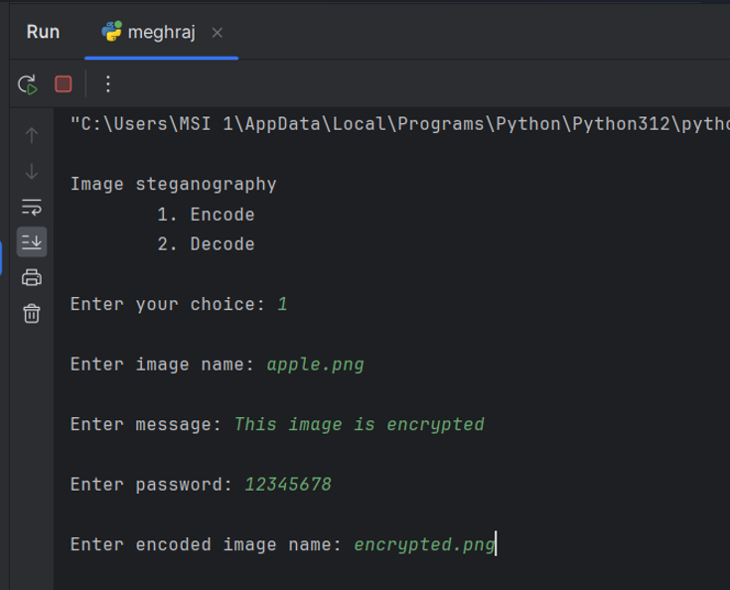
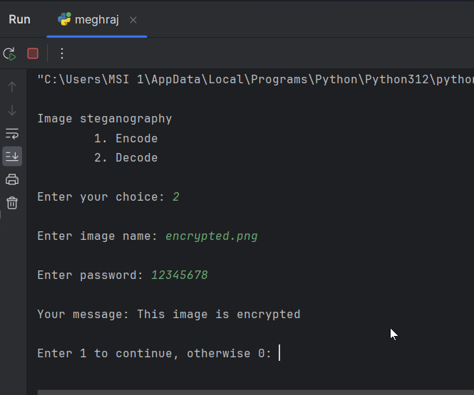
Python code Output

Slide 12
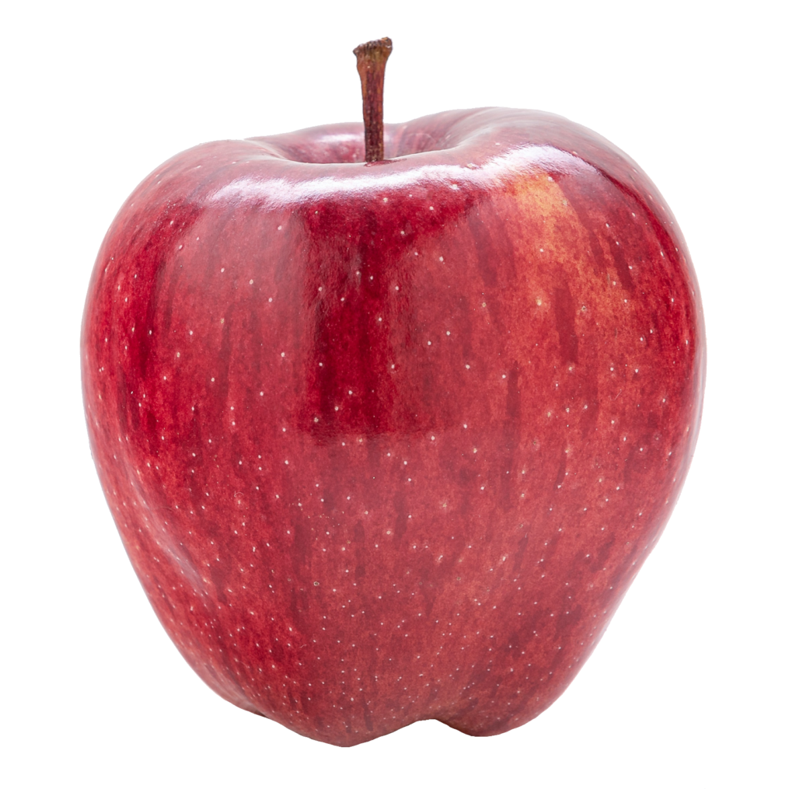
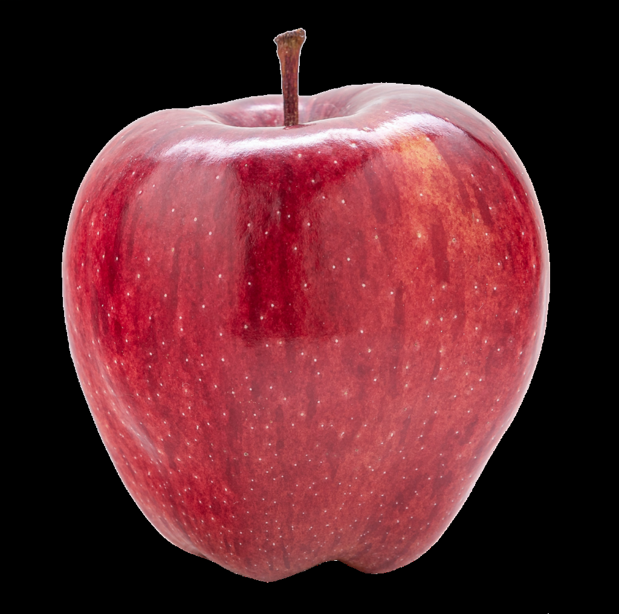
Results
The results of my project were promising, indicating that the Least Significant Bit Steganography technique can be an effective method of hiding secret messages in digital images. The tool successfully encoded and decoded messages without noticeably affecting the visual appearance of the image. Furthermore, the tool was able to withstand various attack methods, demonstrating its effectiveness in maintaining the secrecy of the messages.
Orignal Image
Encoded Image

Slide 13
links
Github repo :- https://github.com/megh212/Image-Steganography-using-LSB-Technique
Youtube video:- https://www.youtube.com/watch?v=hfd3QOsc5f8

